Slide 1
ROCO218: Control Engineering Dr Ian Howard Lecture 6 Inverted pendulum acceleration control

Slide 2
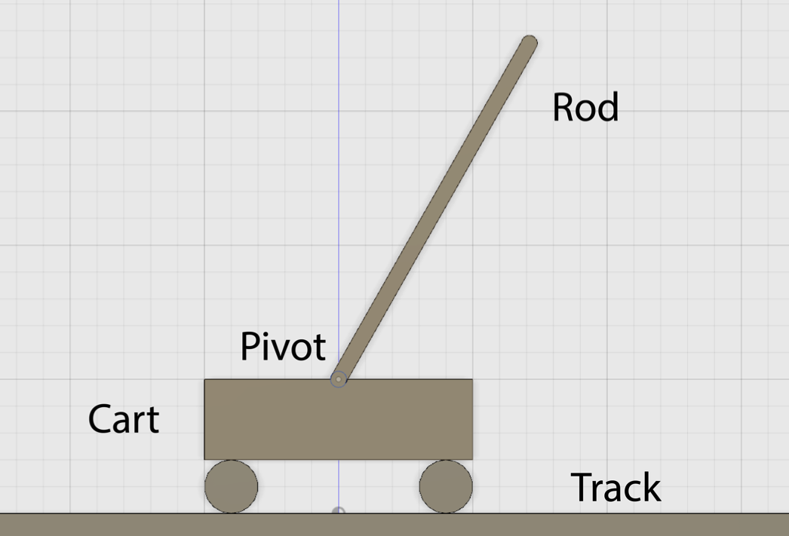
Inverted pendulum state space acceleration control
The linearized differential equation describing the inverted pendulum is given by
Where:
The angle to the vertical is denoted by θ
The coefficient of viciously is denoted by μ
The mass of the pendulum is denoted by m
The moment of inertial of the rod about the center of mass is denoted by I
The length to the centre of mass is denoted by l
The displacement of the pivot is given by x_{p}

Slide 3
Acceleration control of inverted pendulum
Re-writing the differential equation describing the inverted pendulum
To control the pendulum by cart acceleration we can write
This leads to the equation

Slide 4
Acceleration control of inverted pendulum
Given the equation
Let the constant terms be represented by
Which lets us write the equation in the previous canonical form
Choosing state space representations

Slide 5
Acceleration control of inverted pendulum
From the state space representations
From before
Substituting into

Slide 6
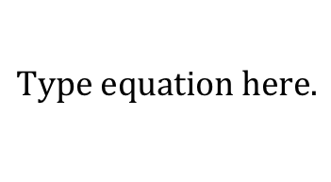
Acceleration control of inverted pendulum
This we have the state space representations
State space notation takes the form
and
Writing in matrix format we therefore have
Where output y is the pendulum angle θ

Slide 7
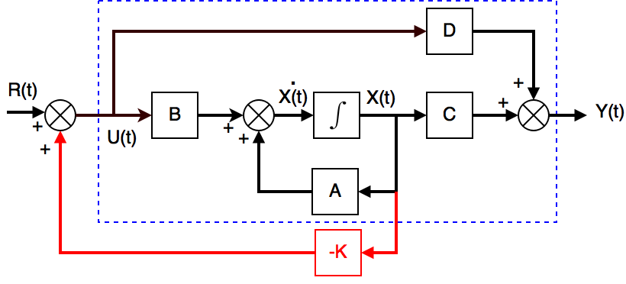
Revision: State space feedback control
Remember state space equations are
and
To achieve state feedback control we substituting in
Thus giving
and
Corresponding signal flow graph is shown below with state feedback path depicted in red
Generally we need to choose the gains using computation, e.g. Matlab
This can be done by pole placement or using optimality criteria

Slide 8
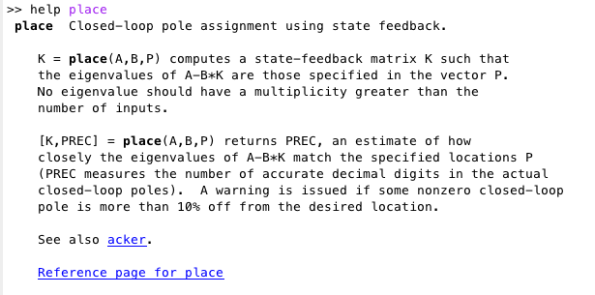
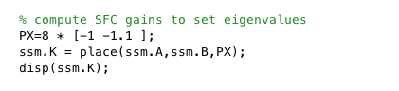
Ackermann SFC gain calculation
Pole placement can be achieved using the Ackermann formula
We can also use the Matlab place command

Slide 9
ROCO218: Control Engineering Dr Ian Howard Lecture 6 Analytical solution of the state space equations

Slide 10
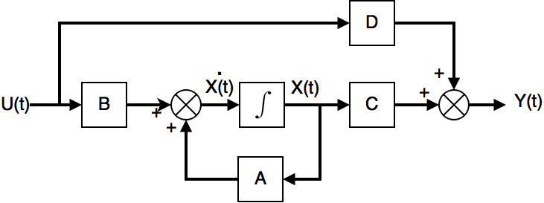
Solution to the state space equation
The matrix state space equations that describe a MIMO system are
As we saw previously they cam be described by the the following system structure
Where A,B,C and D are matrices and the integrator block performs vector integration

Slide 11
Solution to the state space equation
Consider the single 1st order homogeneous differential equation of the form
with initial conditions
This equation has the solution
It is easy to show this by differentiating both size of the equation as follows:
So given
Remember for an exponential
Also when time t = 0 then

Slide 12
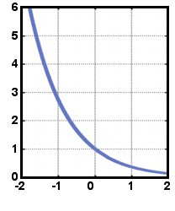
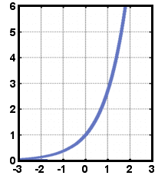
Solution to the state space equation
So the scalar equation
exponential decay
Has the solution
where
If α < 0 then the solution will have exponential decay and finally go to zero
So the system will be stable
exponential growth
If α = 0 then the solution have a constant value
If α > 0 then the solution have exponential growth
So the system will be unstable

Slide 13
Solution to state space equation without input
State space models describe dynamical systems using a set of 1st order ODEs in matrix representation.
That is
Here X(t), Y(t) and U(t) are vectors and A,B C and D are matrices
To solve the first equation, we will first ignore the input term u(t)
We then need to first define the matrix exponential
That is the meaning of the expression:
where A is a matrix

Slide 14
The matrix exponential
The function
must satisfy the following conditions
and
The scalar exponential is defined as
The matrix exponential is similarly defined as
By also including the time term we therefore have the expression

Slide 15
Checking properties of the matrix exponential
The matrix exponential has the following properties
The differential of the matrix exponential is given by

Slide 16
Checking properties of the matrix exponential
Therefore the solution of the equation
in the absence of input is given by
Which can be written as
Where the state transition matrix is written as

Slide 17
Example 1: system output with no input
Consider the system with the state equations
With initial conditions
First we write down the equations in matrix form
Therefore the system matrix A is given by

Slide 18
Example 1: system output with no input
Given the system matrix
This leads to the state transition matrix expression
Since the matrix exponential is defined as
To evaluate it we first need to calculate the terms so we can form the sum

Slide 19
Example 1: system output with no input
Identity matrix
System matrix
Squared system matrix
Cubed
system matrix
And so on …

Slide 20
Example 1: system output with no input
Substituting in these terms

Slide 21
Example 1: system output with no input
It can be seen that

Slide 22
Example 1: system output with no input
So from our expression for the state transition matrix
The homogeneous response to initial conditions is given by
With initial conditions

Slide 23
Example 2: system output with no input
Given a system with a diagonal system matrix
Where the system matrix is
We calculate the matrix exponential as before

Slide 24
Example 2: system output with no input
Identity matrix
System matrix
Squared system matrix
Cubed
system matrix
And so on …

Slide 25
Example 2: system output with no input
Substituting in these terms

Slide 26
Example system output in case of no input
It can be seen that
Homogeneous response to initial conditions is
Note that since system matrix A was diagonal outputs are now decoupled!

Slide 27
System output with input term
In general for a state space system driven with an input u(t)
Taking Laplace transforms with initial conditions
Before taking the inverse Laplace transforms we note that
A product in the s-domain becomes a convolution in the time domain

Slide 28
System output with input term
Taking inverse Laplace transforms
Substituting into the output equation this gives

Slide 29
ROCO218: Control Engineering Dr Ian Howard Lecture 6 Numeric solutions of state space equations

Slide 30
Revision: Using ode45 to perform integration
help ode45
Solve non-stiff differential equations, medium order method.
[TOUT,YOUT] = ode45(ODEFUN,TSPAN,Y0)
with TSPAN = [T0 TFINAL] integrates the system of differential equations y' = f(t,y) from time T0 to TFINAL with initial conditions Y0.
ODEFUN is a function handle.
For a scalar T and a vector Y, ODEFUN(T,Y) must return a column vector corresponding to f(t,y).
Each row in the solution array YOUT corresponds to a time returned in the column vector TOUT.
To obtain solutions at specific times T0,T1,...,TFINAL (all increasing or all decreasing), use TSPAN = [T0 T1 ... TFINAL].

Slide 31
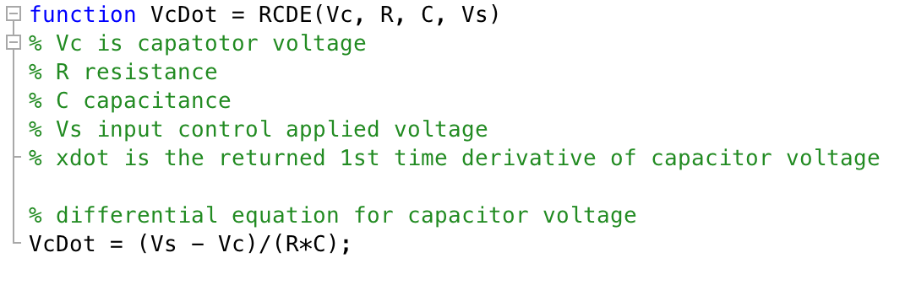
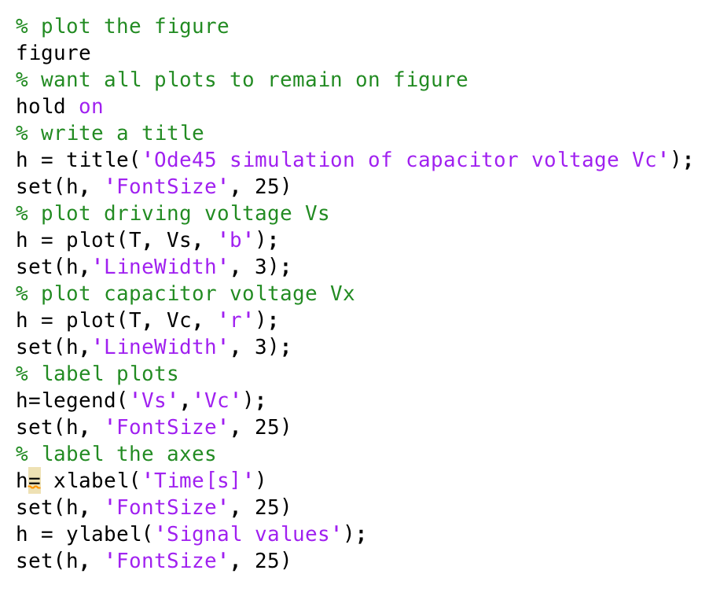
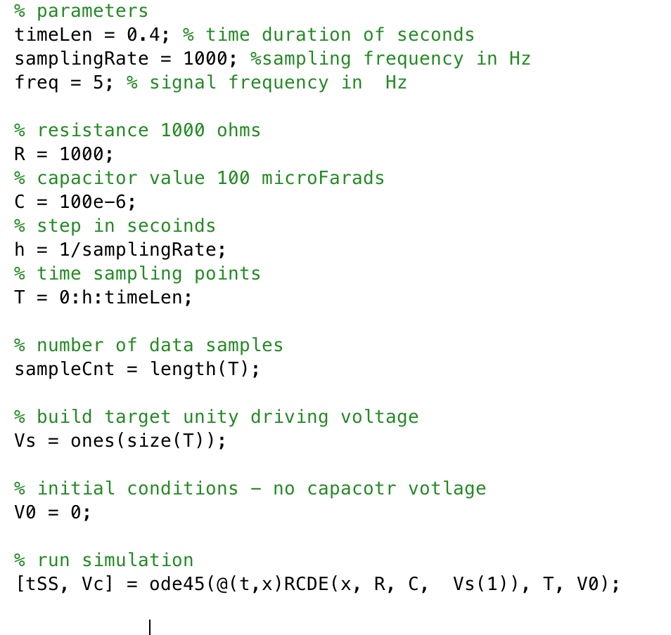
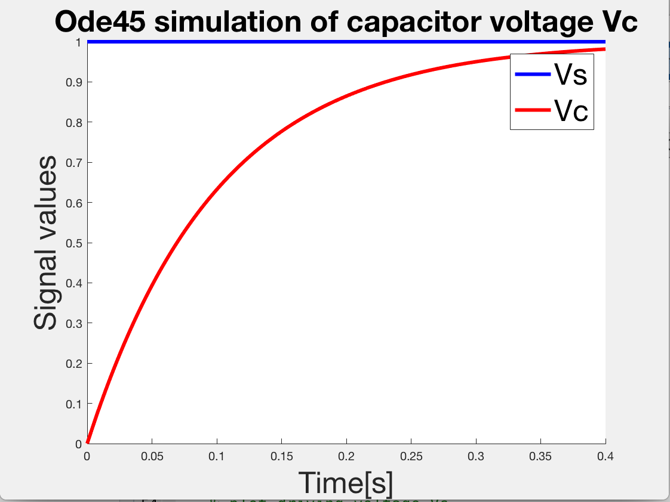
Revision: Using ode45 to perform integration

Slide 32
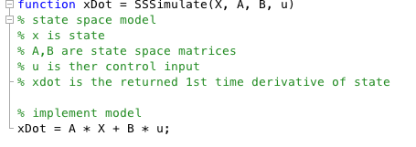
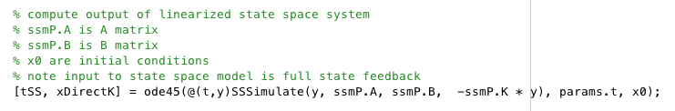
Using ode45 to perform SFC integration
ode45 solve systems of equations of the form y'=f(t,y)
To use ode45 you need to write a function that returns an xDot vector
This is what the state space dynamics equation does. That is
Therefore write a function and pass it the parameters: A, B and u and return xDot
Then ode45 can integrate it for you!

Slide 33
Revision: Euler’s method of integration
This is Euler’s method to solve a 1st order differential equation!
It uses a local linear approximation to the gradient
We can iteratively estimate the value of the function at the next step
Given the relationship
Where
t is time
y is the output value of the function
At initial time t_{o} the output is y_{o}
At future time t_{(n+1)} the output is y_{(n+1)}
h is the step size
Notice the simulation error will rise as the step size increases!

Slide 34
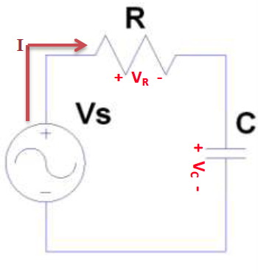
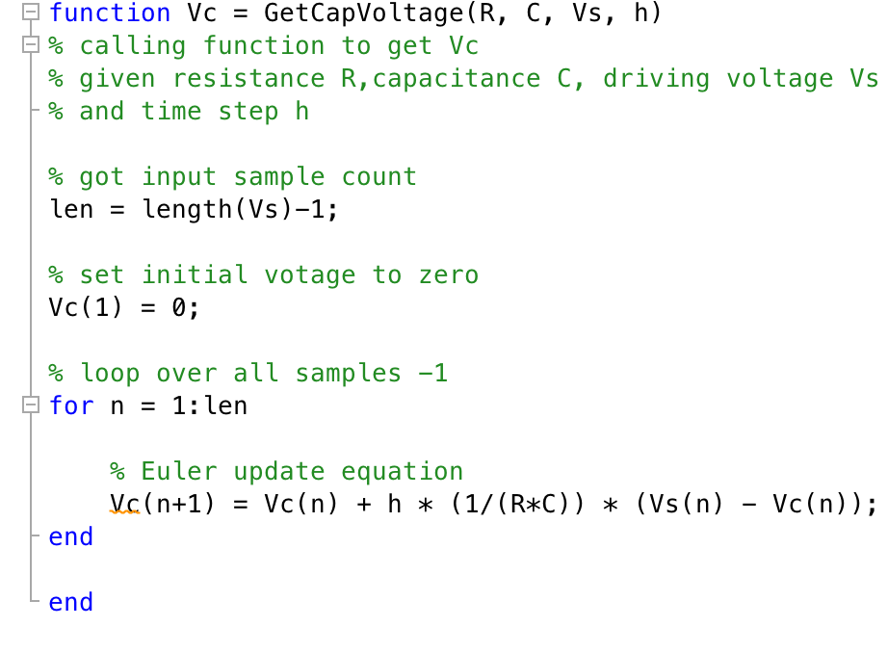
Revision: Implementing Euler integration in Matlab
We can write simple script using the update equation to estimate capacitor voltage is given by the equation

Slide 35
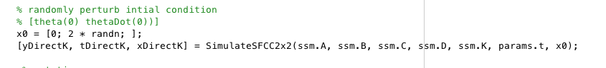
Using Euler method to perform integration for SFC
We need to solve the equations
Where
This time we need to iteratively estimate the state vector X
Thus starting by setting the initial conditions
We then have to calculate the recurrence relationships in a loop
Where state X and input U are now described by a step index to make the recurrence clear
Again we will need t define the time step h

Slide 36
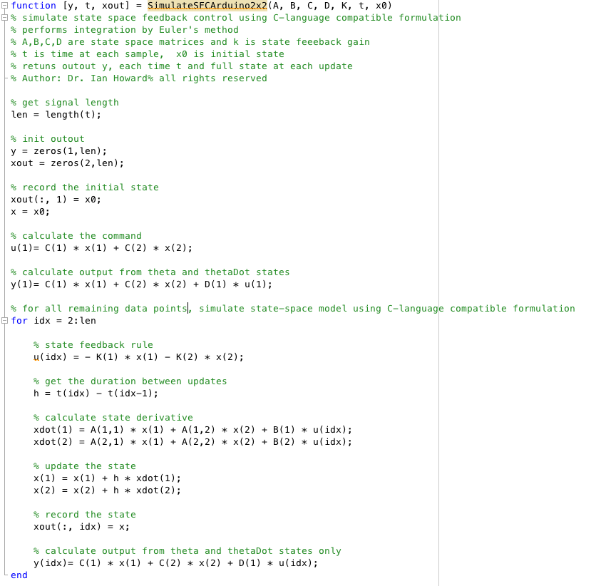
Using Euler method to perform integration for SFC
Initialize
Calculate initial
state feedback
Calculate initial
output
Loop over
all data
Calculate control input
Get time step
xDot = AX+BU
Update the state
Record the state
Calculate output

Slide 37
Interlude 10 minute break

Slide 38
ROCO218: Control Engineering Dr Ian Howard Lecture 6 Linearization of state space models

Slide 39
Linear and non-linear models
We will focus on the analysis of linear models
Linear models
Time invariant model
Time variant model
Non-linear models
Time invariant model
Time variant model

Slide 40
Linear and non-linear models
We will consider time invariant- model with continuous time
However we note that analysis of discrete time models
can be treated in a similar way, but uses difference equations rather than differential equations

Slide 41
Linear and non-linear models
We can find linear approximations to non-linear models around their equilibrium points and then describe them as we would linear time invariant systems using state space methods
Given a non-linear model
We first need to find the equilibrium position.
This occurs when the system is stationary and therefore when the differential is equal to zero

Slide 42
Local linear approximation of gradient
y
In the 1-dimensional case, we can calculate the gradient of a curve at any point by calculating the simple derivative at that point
We can then model the system close to that point with a linear approximation
For example we can model local behavior at the point (x_{o}, y_{o}) using a line with the same gradient at that point
If we have a multidimensional system we need to compute the partial derivatives
y_{o}
x_{o}
x

Slide 43
Ordinary derivatives
With a function of a single variable
The rate of change of z w.r.t. x is given by the full derivative
Straight d symbols used to denote total differential where all variables (x) are allowed to vary

Slide 44
Ordinary derivatives
E.g. given the equation where k is a constant
Let
Use the chain rule to differentiate a function of a function

Slide 45
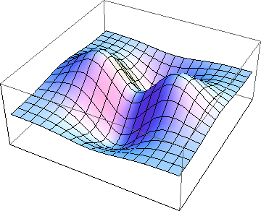
Functions of multiple variables
Z
z = f(x,y)
X
Y
Consider function of two valuables
z = f(x,y)

Slide 46
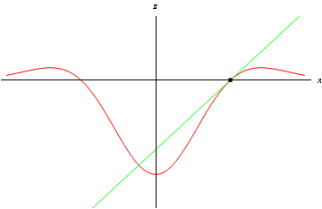
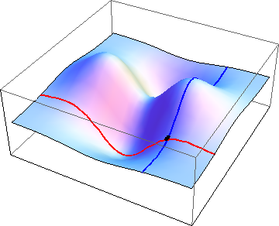
Gradient along two dimensions
Z
z = f(x,y)
X
Can find gradient by differentiating curve w.r.t. x and then evaluating at a given point
This partial differential is denoted by
Y
Keep y constant and follow path along x-axis

Slide 47
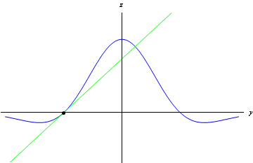
Gradient along two dimensions
Z
z = f(x,y)
X
Can find gradient by differentiating curve w.r.t. y and then evaluating at a given point
This is denoted by
Y
Keep x constant and follow path along y-axis

Slide 48
Partial derivatives
In the case when a function depends on 2 variables
The partial derivative of z w.r.t. x is the ordinary differential w.r.t. x while y is held constant and written as
Curly ∂ symbols used to denote partial differential wrt valuable x
The partial derivative of z w.r.t. y is the ordinary differential w.r.t. y while x is held constant and written as
Curly ∂ symbols used to denote partial differential w.r.t. valuable y

Slide 49
Partial derivatives
E.g. given the equation that is a function of x and y
Since all y terms are treated as constant
Similarly
Since all x terms are treated as constant

Slide 50
1-dimensional Taylor series approximation
State space models are of the form
i.e., a 1st order differential is equated to some function
The function f(x) can be approximated using a Taylor series around a steady-state operating point x_{s}
If we ignore terms higher than the 1st differential then we have the approximation

Slide 51
1-dimensional Taylor series approximation
At steady state equilibrium the system is stationary
Therefore we have the condition that
Therefore the 1st order Taylor approximation
since the 1st term on the RHS is zero so the expression simplifies to
Gradient at the equilibrium
Deviation from the equilibrium

Slide 52
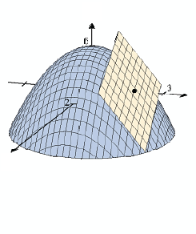
Linearization of high-order non-linear systems
If we have the equation
Where
To linearize a high order non-linear system using a Taylor expansion, we need to calculate the Jacobian matrix and evaluate it at its equilibrium position(s)
This leads to a local approximation of the function

Slide 53
Jacobian example
If we have the equation
It is easy to see that

Slide 54
ROCO218: Control Engineering Dr Ian Howard Lecture 6 Example state space model of a simple pendulum

Slide 55
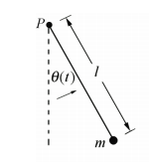
Fixed point mass pendulum
Gravitation force acting on mass leads to torque about the pivot given by
A resistance torque to movement is due to the moment of inertia of system
distance
=l.sin(θ)
For point mass
force=mg

Slide 56
State space model of simple pendulum
From differential equation for point mass pendulum
Choosing state variables of angle and angular velocity
distance
=l.sin(θ)
Thus
force=mg
NB: This is a non-linear equation

Slide 57
State space model of simple pendulum
We now find the equilibrium points
First term is
Therefore at equilibrium
Second term is
Therefore at equilibrium
We now need to calculate the Jacobian to linearize the system at the equilibrium point.
I.e. we need to compute J where

Slide 58
State space model of simple pendulum
To calculate the Jacobian we look at the functions:

Slide 59
State space model of simple pendulum
Substituting in the partial derivative terms and evaluating at the zero equilibrium point we get
This has the associated linear system
where
The characteristic polynomial is give by the equation

Slide 60
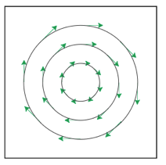
State space model of simple pendulum
We solve the characteristic polynomial for the eigenvalues λ
These eigenvalues λ are complex conjugate, this means that there are oscillatory dynamics.
The dynamics are neutrally stable since the eigenvalues are on the imaginary axis.
This means that, whatever the initial condition is, the phase plane trajectory motion is a circle centered at the origin and the amplitude determined by the initial condition

Slide 61
State space model of simple pendulum
Substituting in the partial derivative terms and evaluating at the π equilibrium point we get
This has the associated linear system
where
The characteristic polynomial is give by the equation

Slide 62
State space model of simple pendulum
We solve the characteristic polynomial for the eigenvalues λ
The eigenvalues λ are +ve and –ve real values,
This indicates that the dynamics are unstable.

Slide 63
For fixed point mass pendulum
The pendulum linear system matrix equation
Implies that the linearized equation of motion for point mass pendulum is
We can also take Laplace transforms with zero initial condition
distance
=l.sin(θ)
force=mg
To get angular frequency substitute
Where f is the frequency of oscillation of the pendulum in Hz

Slide 64
ROCO218: Control Engineering Dr Ian Howard Lecture 6 2016R exam for ROCO319 Modern Control Solutions to relevant questions

Slide 65
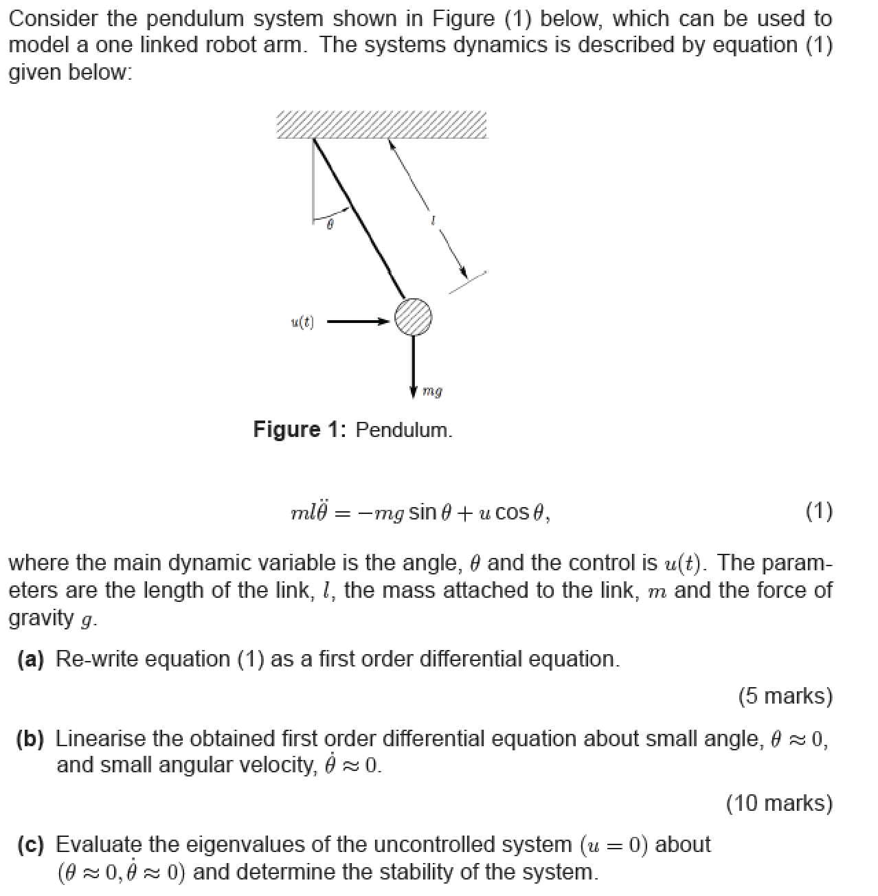
Q1: State space derivation and analysis

Slide 66
Q1: State space derivation and analysis
System dynamics are described by
To re-write as 1st order equations we first let
Choosing state variables X
And also

Slide 67
Q1: State space derivation and analysis
We linearize using the Jacobian, we first need to find the equilibrium
Equilibrium in the absence of input u occurs when
Here we only consider the first solution
Writing the state equations as the functions
The Jacobian matrices for system and control are given by

Slide 68
Q1: State space derivation and analysis
Given the functions
Differentiating w.r.t. to state variables
Substituting in terms, the Jacobian system matrix is given by

Slide 69
Q1: State space derivation and analysis
Given the functions
Differentiating w.r.t. to control input
Substituting in terms, the Jacobian control matrix is given by

Slide 70
Q1: State space derivation and analysis
The state space equation is therefore
The eigenvalues of the uncontrolled system are determined by the equation

Slide 71
Q1: State space derivation and analysis
The expression
Leads to the characteristic equation
It can be seen that the eigenvalues are complex conjugate
therefore there are oscillatory dynamics and system is neutrally stable

